Slide 1

Cloud and what it means to AGT Sales Kickoff – Cloud Education Session
Gerhard Koch – Chief Development Architect
February 2012

Slide 2
Table Of Content
Quick Introduction to Cloud: Characteristics, Taxonomy & Economics
Cloud 2012 – A market view from Gartner
Market size estimates of Cloud BPaaS, SaaS, PaaS and IaaS
Cloud Landscape Analysis
5 basic Cloud Delivery Models
How to identify Business Opportunities where Cloud “fits”
Proposed AGT Cloud Architecture
Potential AGT Cloud Use Cases
Key Take Aways
Notes:
Update at the end

Slide 3
Introduction to Cloud: Characteristics & Economics
Notes:
Needs to be moved to the front of the presentation and included where applicable

Slide 4

What the Cloud Means to Customers
Ready-to-run
Faster time-to-deploy
Low start-up cost
Pay-as-you-go
Frequent functional upgrades
Notes:
So, what does cloud computing mean to you?
Well, cloud computing turns conventional software delivery on its head in a number of ways:
Software in the cloud is ready to run, and you get a faster time to go live: You can be up and running with ERP, CRM, Ecommerce applications, on a local or global scale, within a few months, rather than the six to 12 months it would take to install and troubleshoot conventional servers and software.
With cloud computing, you pay as you go. You pay for the applications you use, and nothing more, unlike conventional systems where you have a major up-front investment for hardware and software. You benefit from batter cash flow and far greater IT flexibility.
Upgrades, maintenance, and system administration take place in the cloud, so you don’t have to spend nights or weekends supervising a new version upgrade or a failed server. And the cloud adjusts to your performance needs, dynamically assigning server cycles whenever and wherever you need them, and automatically adjusting to spikes in your business.
Cloud computing even makes it easy to grow your business and support remote workers and locations, or support a highly mobile sales or service team, because people can access the cloud instantly from any browser, desktop or mobile.
So, what makes a world class data center….?
4

Slide 5
In more detail …
“Cloud” is a new consumption and delivery model inspired by consumer Internet services.
Enabled by Virtualization, (Service) Automation, Standardization
Cloud enables:
Access from anywhere (typically Web)
Self-service
Sourcing options
Economies-of-scale
Location independent resource pooling
Rapid Elasticity
Flexible Pricing Models
“Cloud” represents:
The Industrialization of Delivery for IT supported Services
Multiple Types of Clouds will co-exist:
Private, Public, Hybrid, Community
Workload and / or Programming Model Specific

Slide 6



What does Industrialization of IT Services mean
1886
around 1913
2000
individual
standardized
networked
„Optimiiation of Customer wishes“
„Optimization of Productivity“
„Optimize vertical range of Manufacture“
Industrialization of Production
Cloud Appearance
Cloud Adoption
Connected
Cloud Markets
Mid 2000
2012
2015

Slide 7
Most important Cloud Taxonomy
Cloud User Roles
Three basic concepts:
Service Creator - Service Provider - Service Consumer
Recursive instantiation:
Provider acts as Consumer to be Provider again
Consumer consumes services to become Provider
Roles application:
Each role could be filled by one or more persons (e.g., an organization as a logical construct or a single human being)
One person can fill part of a role, one role or multiple roles
Cloud Service Creator
may include
may include
Cloud Service Provider
Cloud Service Consumer
may act as a

Slide 8
Most important Cloud Taxonomy
Cloud Servíces Layer
SaaS
Cloud based delivery of complete software applications that run on infrastructure the SaaS vendor manages. SaaS applications are accessed over the Internet and typically charged on a subscription basis. (typically but not limited to: Services for Billing, CRM, Collaboration, ERP, Environmental Health & Safety, HR, Social Software, …)
PaaS
Delivery of a virtualized application runtime platform that has a software stack for developing applications or application services. PaaS applications and infrastructure are run and managed by the services vendor. (typically but not limited to: Application Lifecycle Management Services for Integration, Databases, Middleware Scaling, Development Environments)
IaaS
Delivery of raw, virtualized computing infrastructure such as servers, storage and network as a service to build applications. IaaS vendors let enterprises customize infrastructure to their application needs. (typically: Storage, Server and Network Virtualization & Resource Pooling)
Source: http://cloudtaxonomy.opencrowd.com/

Slide 9
Most important Cloud Taxonomy
Cloud Management Layer or Cloud Software
OSS – Operational Support System
Packages and tools for managing cloud scale systems that can be used to create private clouds or used by service providers to build cloud offerings. (typically used for Cloud Service Creation, Instantiation, Service Lifecycle, Service Termination, Service Catalogues, Configuration Automation, Image Management)
BSS – Business Support System
Basically it deals with the taking of orders, payment issues, and revenues. The role of business support systems in a service provider is to cover following main areas: Product management, Customer management, Revenue management, Order management, Offering Management, Billing and Charging

Slide 10
Cloud Economics
Infrastructure Leverage
Virtualization of Hardware
Drives lower capital requirements
Utilization of Infrastructure
Virtualized environments only get benefits of scale if they are highly utilized
Self Service
Clients who can “serve themselves” require less support and get services
Labor Leverage
Automation of Management
Take repeatable tasks and automate
Standardization of Workloads
More complexity = less automation possible = people needed

Slide 11



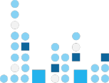

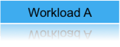
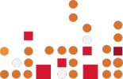
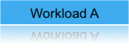
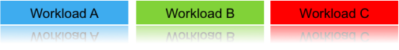
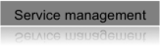
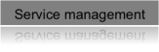

What is different about cloud computing?
Without cloud computing
With cloud computing
Virtualized resources
Automated service management
Standardized services
Location independent
Rapid scalability
Self-service
Software
Hardware
Storage
Networking
Software
Hardware
Storage
Networking
Software
Hardware
Storage
Networking
Note: Elements of cloud computing taken from NIST, Gartner, Forrester and IDC cloud computing definitions

Slide 12
From … To …
Capability
From
Faster Time-to-Market
Reduced
Cost
Increased Flexibility
To
Server/Storage Utilization | 10-20%
Self service | None
Provisioning | Weeks
Change Management | Months
Service Creation | Weeks
Metering/Billing | Fixed cost model
Payback period for new services | Years
70-90%
Unlimited
Minutes
Days/Hours
Minutes
Granular
Months
Cloud Computing enables innovative business models by providing IT services from a dynamic infrastructure faster, simpler and cheaper
Legacy environments
Cloud enabled enterprise

Slide 13
Cloud 2012: A market view from Gartner
Notes:
Needs to be moved to the front of the presentation and included where applicable

Slide 14
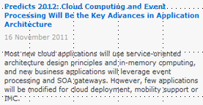
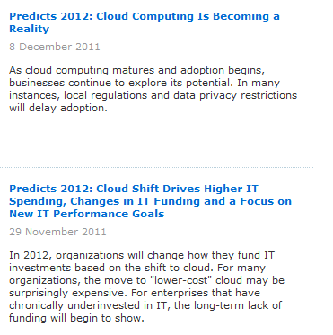
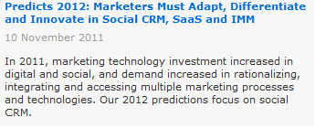
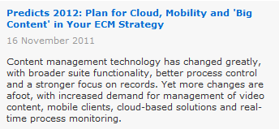
Excurs: Cloud 2012 from Gartner
http://www.gartner.com/technology/research/predicts/

Slide 15
Marketsize of BPaaS, SaaS, PaaS and IaaS
Notes:
Needs to be moved to the front of the presentation and included where applicable

Slide 16
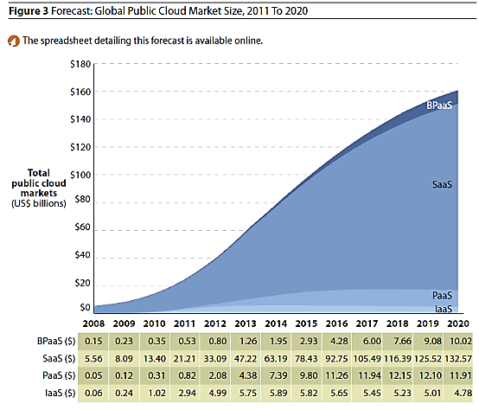
Excurs: Cloud 2012 Marketsize
http://blog.goaruna.com/tag/cloud-market-size/

Slide 17
Cloud Landscape Analysis
Notes:
Needs to be moved to the front of the presentation and included where applicable

Slide 18
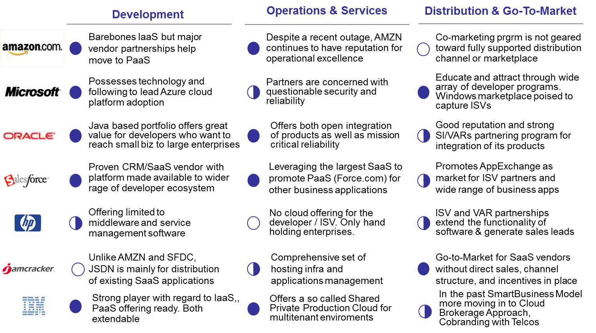
Cloud Landscape Analysis – no clear leader

Slide 19
New Play PaaS - PaaS is important for rapid scale out of customer base ... very unmature market
Gartner sees 60 active participants in the PaaS market. The majority do not make more than $5M total company revenue.
Part of the PaaS market is spinning off from the traditional AIM (App Infrastructure Midware), using a variety of architectural underpinnings to achieve scalable Cloud Application Infrastructure Services.
IBM, Microsoft, Salesforce.com, and Oracle have middleware that serves as a good base for more comprehensive offerings.
Consolidation is expected in the next 5 years.. A normal cycle (innovation, market consolidation, market commoditization)
The PaaS market is very immature, making apples to apples comparisons difficult..
Major Cloud Players | IaaS | PaaS | SaaS | Partner | Public/Private/AppStore | Comment
IBM | SPPC | 2012 |  | SAP | Public / Private/
SalesForce.com |  | Force.com | CRM | VMware /VMForce | Public / Private/ App Store | Acquired Heroku (Ruby)
Microsoft | Windows Azure |  |  | Soyatec (Java) | Public / Private/ App Store
Oracle | Amazon | Amazon | OOD | Amazon (IaaS, PaaS) | Public / Private /App Store | PaaS: on Amazon
HP (newly ann plans) | 2011 | By 2012 |  | 2010 partner = MSFT | Public / ? /App Store | Vague Cloud Plans
Google |  | AppEngine | GA |  | Public / Private/ App Store | GA=Google Apps
Amazon | EC2 | Beanstalk | S3, etc | Oracle | Public / Private/ App Store Amazon Appstore Dev Portal | Acquired Beanstalk $99 Appstore (dev, buy,sell)
Note:
Oracle is a SaaS provider (via Oracle On Demand) – but not a PaaS provider
Oracle is a PaaS enabler via Oracle technology that runs on Amazon EC2
Notes:
Gartner Competitive Landscape: PaaS WW, 2010

Slide 20
5 basic Cloud Delivery Models
Notes:
Needs to be moved to the front of the presentation and included where applicable

Slide 21


5 different Cloud Delivery Models define the spectrum of activities
Private
Public
Enterprise
1
Enterprise
Data Center
2
Enterprise
Data Center
3
Enterprise
4
Enterprise A
5
User A
User B
User C
Enterprise B
User D
User E
ÂGT operated
AGT owned and operated
Enterprise C
Private Cloud
Managed Private Cloud
Hosted Private Cloud
Shared Cloud Services
Public Cloud Services
Enterprise owned
Either enterprise operation or 3rd party
Fixed price or time and materials services, Internal network
Dedicated assets
Cloud provider owned and operated
Centralized, secure delivery center
Fixed price, time and materials, or pay as you go
Internal network
Dedicated assets
Mix of shared and dedicated resources (Multitenancy)
Shared facility and staff
Pay as you go
VPN access or public internet
Shared resources
Elastic scaling
Pay as you go
Public internet

Slide 22
How to identify Cloud Business Opportunities
Notes:
Needs to be moved to the front of the presentation and included where applicable

Slide 23
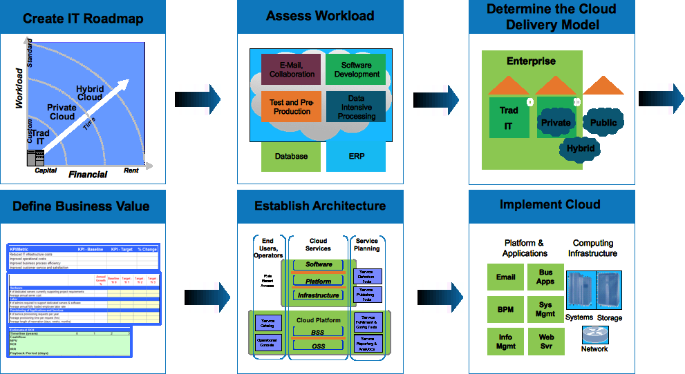
How to identify Business Opportunities where Cloud can help .. We suggest 6 Steps ..
1
2
3
Brainstorm Cloud Opportunities
Assess Workload
Determine the Cloud Delivery Model
P&S
R&D Arch.
P&S
6
5
4
Implement Cloud
Establish Architecture
Define Business Value
R&D
R&D Arch.
P&S

Slide 24
Now: Start into AGT Cloud Architecture
Notes:
Needs to be moved to the front of the presentation and included where applicable

Slide 25
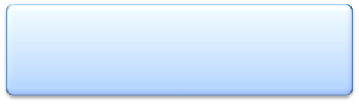


AGT Cloud – Architecture Overview
Security, Resiliency, Performance & Consumability
AGT Cloud Focus
Cloud Service Consumer
Cloud Service Provider
Cloud Services
AGT Cloud Management Platform (ACMP)
Cloud Service Integration Tools
Standards
Business-Process-as-a-Service
Business Support Services (BSS)
Operational Support Services (OSS)
Extensible
Customer
Software-as-a-Service
Integratable
Partner
Access Domain
Integration Domain
Provider
Flexible
Platform-as-a-Service
Cloud Service Creator
Scalable
Infrastructure-as-a-Service
Cloud
Service Creation
Secure
Infrastructure (C2 Servers, Virtulaized Sensors, Storage, Networks, Specialized Servers, Workload Optimized Systems for Cross Industries
Consumable

Slide 26
AGT Cloud – e.g SaaS View
Software As Service (SAAS)
Social
Analytics
Business
Analytics
Sensor Data
As Service
Data Aggregation
Data
Fusion
Pollution
Map
Platform As Service (PAAS)
…
Air Quality
Assistant
Traffic
Control
Infrastructure As Service (IAAS)

Slide 27
Potential AGT Cloud Use Cases
Notes:
Needs to be moved to the front of the presentation and included where applicable

Slide 28

What is the Business Model we want to enable via Cloud Computing? High Volume Production or High Value Services ?
What would be the benefits for customers and AGT Customer: Cheaper and/or Adaptive prices ! AGT: Broader Customers Base !
Both: Enable Higher Value much more flexible & faster!
What are the consumption models we want to offer to customers based on the Business Model
Private, Public, Hybrid, Community ?

Slide 29
Some ideas for Cloud Use Cases
SAAS
Value Added Services
Core C2 Services
C2-aaS
One datacenter serving multiple cities driving cost reduction (reduction of sites) of C2 Server infrastructure (rapid deployment for new cities)
PAAS
IAAS
Sensor Data-aaS
Trade Sensor Data to customers via Cloud Market Place very rapidly
Analytics-aaS
Flexible Integration of Analytics
Services into C2-aaS or other Mgmt Systems (such as Traffic or Weather Prediction, etc)

Slide 30
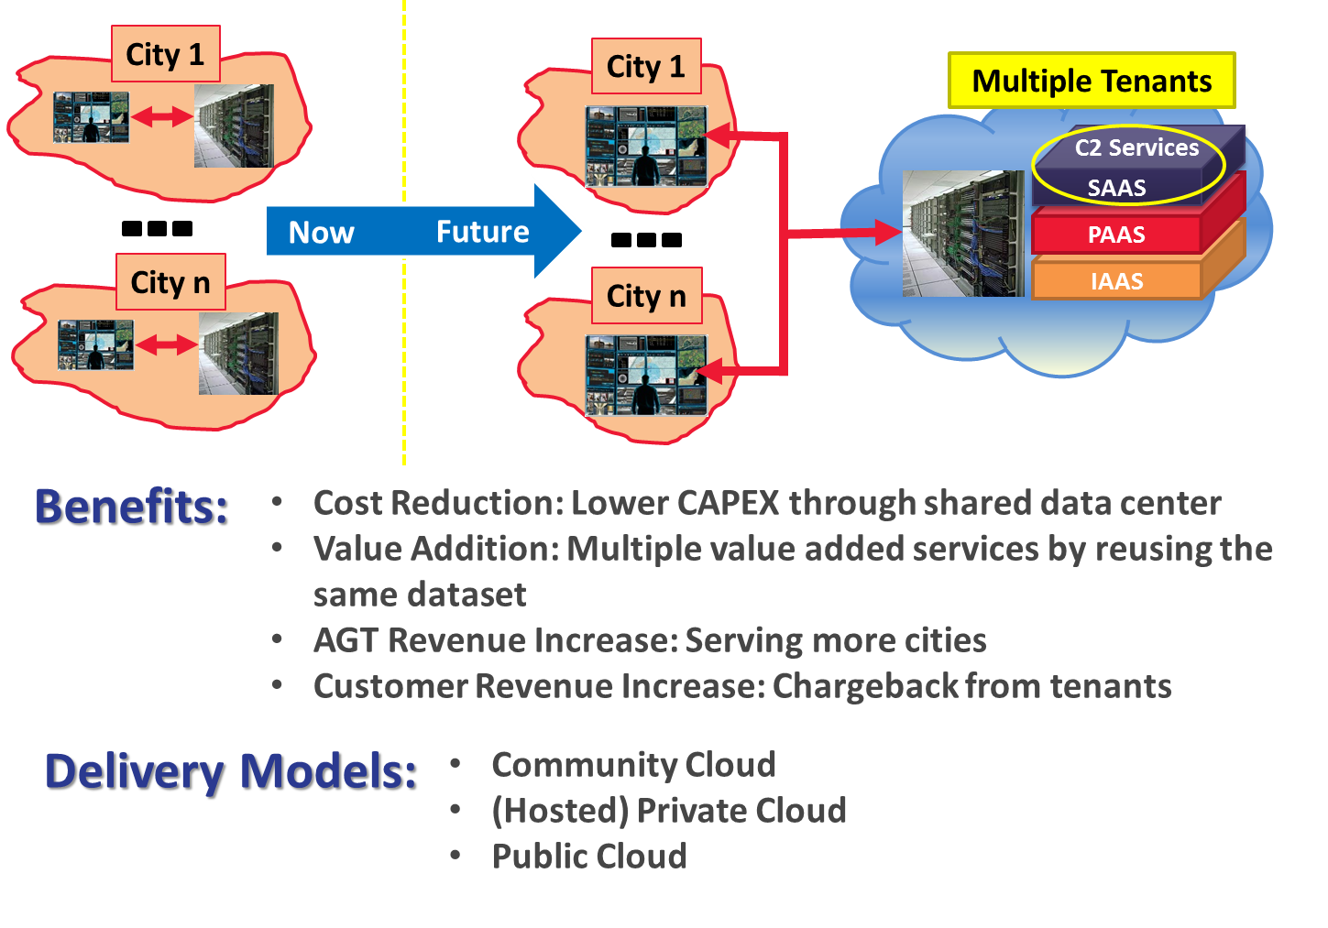
Drilldown of Use Cases – C2-aaS

Slide 31

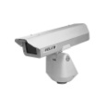
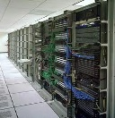

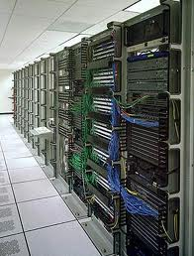
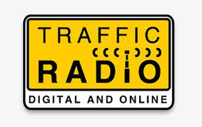

Drilldown of Use Cases – Sensor Data-aaS
Multiple Tenants
Shared Sensors
C2 Services
SAAS
PAAS
IAAS
Single Tenant
Now
Future
Benefits:
Cost Reduction : Lower CAPEX through Shared Sensors
Value Addition : Same sensor data used for different purpose
AGT Revenue Increase : More customers in the same city
Customer Cost saving: No deployable sensor and server hardware Infrastructure
Delivery Models:
Community Cloud
(Hosted) Private Cloud
Public Cloud

Slide 32
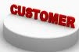
Cloud use case 3: Analytics as-a-Service
Traffic
Prediction
Object/Image
Recognition
1
…
Adaptive
Video Analysis
Platform As Service (PAAS)
CORE (C2) SERVICES
2
Software As Service (SAAS)
...
Infra As Service (IAAS)
Sensors
N
Benefits:
Cost Reduction : Lower CAPEX through Shared Sensors
Value Addition : Analytics as value added service
AGT Revenue Increase : Many valued added services with extra cost provided to customer on top of Core (C2) services
Customer Cost saving: Getting value added services as need basis (pay per use)
Delivery Models:
Community Cloud, (Hosted) Private Cloud and Public Cloud

Slide 33
Key Take Aways
Notes:
Needs to be moved to the front of the presentation and included where applicable

Slide 34
Key Take Aways
Get clarity on the Cloud Business Models we want to drive
When evaluating cloud solutions, we need to be sure to check out whether the various offerings perform as expected. Mandatory checkpoints when evaluating Cloud Solutions: (hands-on experience, proof-of-concept, test environments, etc.)
Before we can deploy a successful AGT cloud offering for customers, we should first lay the foundation with an internal AGT private cloud (“eat our own dog food”)
Recommendation: AGT focuses initially on SaaS offerings and look for strong partners in IaaS and PaaS to scale out future customer base

Slide 35

Contact
Gerhard Koch
AGT R&D Chief Development Architect
Tel.: +49 151 4222 4453 E-Mail: gkoch@agtgermany.com

Slide 37
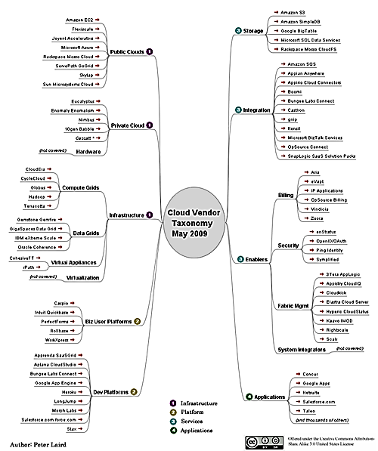

Slide 38
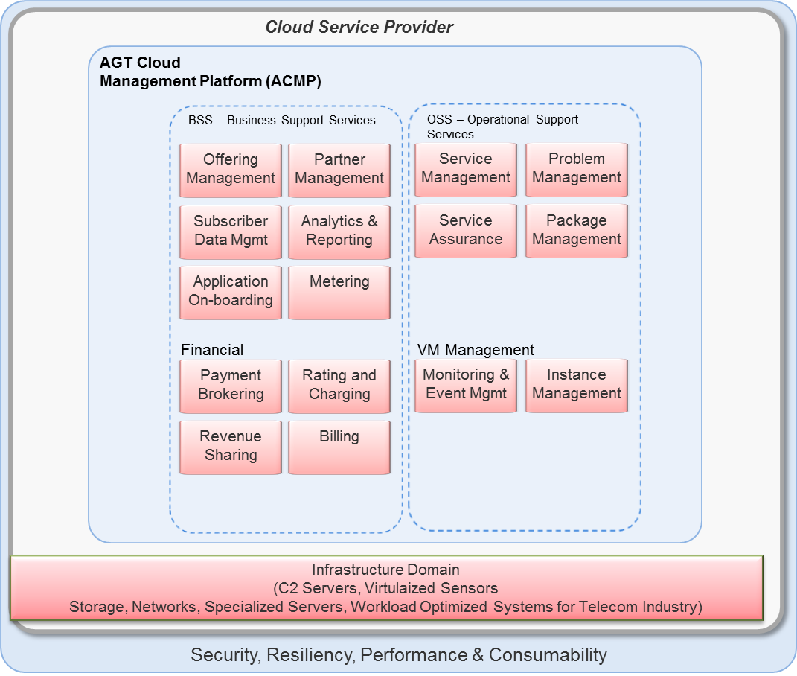
AGT Cloud – Charging & Managing Cloud Services Architecture

Slide 39
Drilldown of Use Cases – Analytics-aaS
TBD

